Slide 1
Marketing Analytics Business AI Workshop by Ali Tarraf
17 Feb 2020

Slide 2
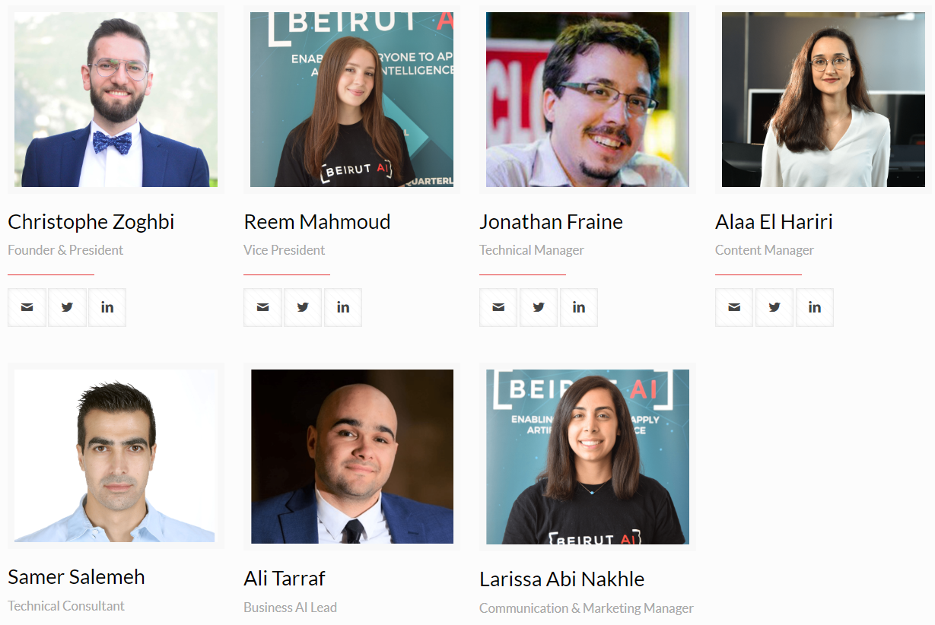
Team Beirut AI

Slide 3
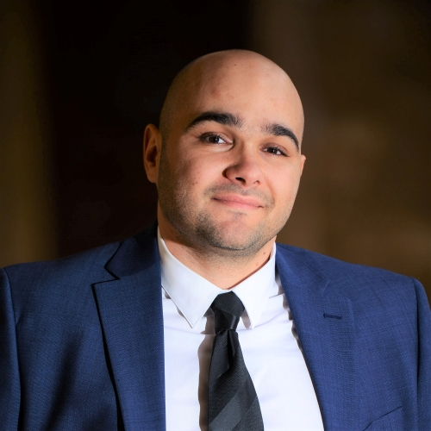


Meet the Beirut AI Marketing Analytics Workshop facilitators
Ali Tarraf
Elissar Abdel Khalek
Mario Karam

Slide 4
Agenda
1
Applied AI in Business - Ali
Introduction to Power BI – Elissar
Marketing Business Case - Ali
Solving Business Case – You
Presentation of solution – You
Conclusions – Ali
Intro to Beirut AI Business Workshop - Ali
Intro AI
Applied AI World Case
Applied AI MENA Case
Intro
Hands on
Vote on next Business AI workshop topics
Intro to the case
Summary
2
3
4
6

Slide 5
Agenda
1
Intro to Beirut AI Business Workshop - Ali
2
Applied AI in Business - Ali
Intro AI
Applied AI World Case
Applied AI MENA Case
3
Introduction to Power BI – Elissar
Intro
Hands on
4
Marketing Business Case - Ali
Intro to the case
Solving Business Case – You
Presentation of solution – You
6
Conclusions – Ali
Summary
Vote on next Business AI workshop topics

Slide 6
Business AI Workshop Concept and motivations

Slide 7




The Beirut AI Business Workshop hopes to bring clarity to community submitted business problems by empowering participants to develop a tailored AI solution plan in each workshop.
Business Workshop
You have a business problem
Submit it to Beirut AI
If it meets the criteria's
Beirut AI Business Workshop
Learn about strategies and tools
Connect with industry experts
Prepare with our team for a …
Go back with a plan of attack
You have a solution plan

Slide 8
Examples ideas to be submitted to the Business Workshop can include…
Examples
I work in the management consulting industry and identifying Request for Proposals is a major pain. How can Business AI help?
A friend is complaining about machine downtime in his plastics manufacturing factory. How can Business AI help?
A retail supermarket is complaining about a decline in repeat sales. How can Business AI help?
Criteria
Business challenge be from your existing work challenges
Business challenge can come from any industry (retail, manufacturing, logistics, hospitality …)
You must be willing to prepare and give a Business AI workshop about your business challenge
The solution must include at least one digital technology component related to data

Slide 9
Agenda
1
Intro to Beirut AI Business Workshop - Ali
2
Applied AI in Business - Ali
Intro AI
Applied AI World Case
Applied AI MENA Case
3
Introduction to Power BI – Elissar
Intro
Hands on
4
Marketing Business Case - Ali
Intro to the case
Solving Business Case – You
Presentation of solution – You
6
Conclusions – Ali
Summary
Vote on next Business AI workshop topics

Slide 10
Applied AI in Business The case for the MENA region

Slide 11
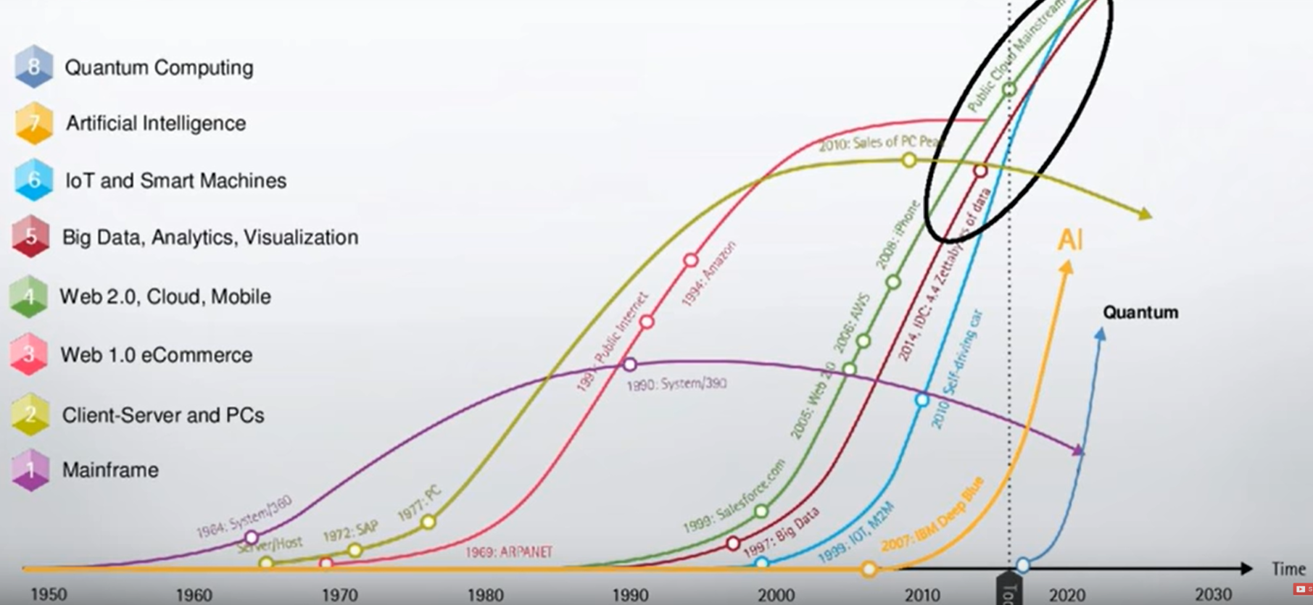
Digital Technology Waves are having a significant impact on society in the last 70 years.
Source: https://www.youtube.com/watch?v=Ned7VPFByMI

Slide 12
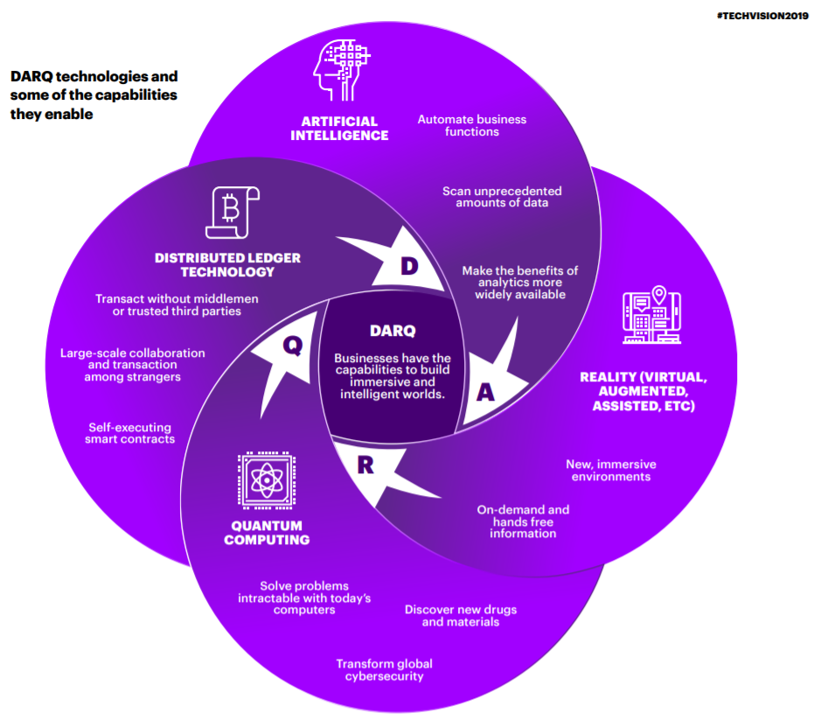
Source: https://www.accenture.com/_acnmedia/pdf-94/accenture-techvision-2019-tech-trends-report.pdf000000

Slide 13
What is AI? / Basic Questions answered by Professor John McArthy
Q. What is artificial intelligence?
A. It is the science and engineering of making intelligent machines, especially intelligent computer programs, but AI does not have to confine itself to methods that are biologically observable.
Q. Yes, but what is intelligence?
A. Intelligence is the computational part of the ability to achieve goals in the world. Varying kinds and degrees of intelligence occur in people, many animals and some machines.
Source: http://jmc.stanford.edu/artificial-intelligence/what-is-ai/index.html

Slide 14








How can AI help our society and economies grow?
Traditional Growth
Model
Capital + Labor + TFP
Adapted Growth
Model
Capital + Labor + TFP + AI
Source: https://www.accenture.com/_acnmedia/pdf-94/accenture-techvision-2019-tech-trends-report.pdf

Slide 15
Agenda
1
Intro to Beirut AI Business Workshop - Ali
2
Applied AI in Business - Ali
Intro AI
Applied AI World Case
Applied AI MENA Case
3
Introduction to Power BI – Elissar
Intro
Hands on
4
Marketing Business Case - Ali
Intro to the case
Solving Business Case – You
Presentation of solution – You
6
Conclusions – Ali
Summary
Vote on next Business AI workshop topics

Slide 16
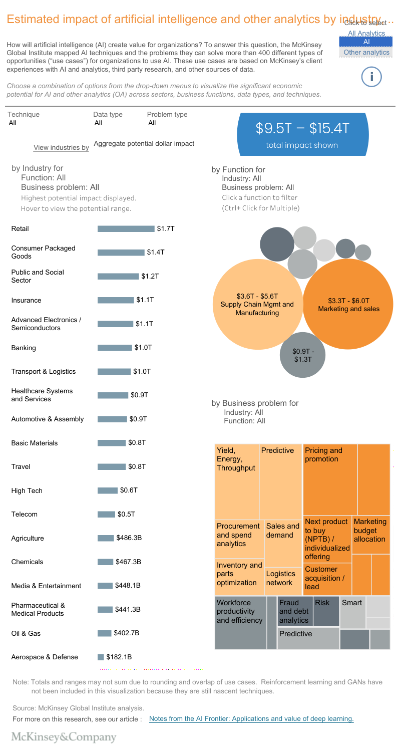
What is the impact of AI ad analytics on different industries world wide?
https://public.tableau.com/shared/MZ2GN8WXH

Slide 17
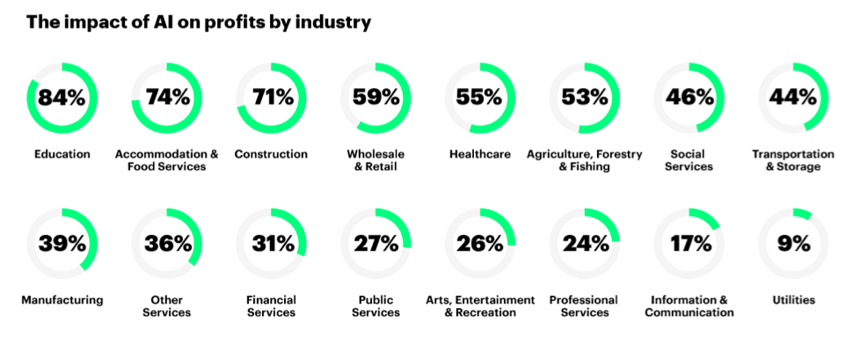
Summary of the impact of AI on profits by industry
Take turns to suggest one AI application per industry
Source: https://www.accenture.com/us-en/insight-ai-industry-growth
Notes:
Put here a list of ideas for each industry…

Slide 18
A specific examples from HBR showing how a business experiments with AI from “moon shot” project to “low hanging fruits”.
In 2013, the MD Anderson Cancer Center launched a “moon shot” project: diagnose and recommend treatment plans for certain forms of cancer using IBM’s Watson cognitive system. But in 2017, the project was put on hold after costs topped $62 million—and the system had yet to be used on patients.
At the same time, the cancer center’s IT group was experimenting with using cognitive technologies to do much less ambitious jobs, such as making hotel and restaurant recommendations for patients’ families, determining which patients needed help paying bills, and addressing staff IT problems.
The results of these projects have been much more promising: The new systems have contributed to increased patient satisfaction, improved financial performance, and a decline in time spent on tedious data entry by the hospital’s care managers.
Our study of 152 projects in almost as many companies also reveals that highly ambitious moon shots are less likely to be successful than “low-hanging fruit” projects that enhance business processes.
Source: https://hbr.org/2018/01/artificial-intelligence-for-the-real-world

Slide 19
Looking at different types of AI from the business perspective, we find three categories of applications consisting of automation, insights, and engagement.
Process Automation of digital and physical tasks
Cognitive Insights using algorithms to detect patterns in vast volumes of data and interpret their meaning
predict what a particular customer is likely to buy;
Cognitive Engagement employees and customers using natural language processing chatbots
replacing lost credit or ATM cards, reaching into multiple systems to update records and handle customer communications
“reading” legal and contractual documents to extract provisions using natural language processing
transferring data from e-mail and call center systems into systems of record
identify credit fraud in real time and detect insurance claims fraud;
analyze warranty data to identify safety or quality problems in automobiles and other manufactured products
product and service recommendation systems for retailers that increase personalization, engagement, and sales
health treatment recommendation systems
intelligent agents that offer 24/7 customer service addressing
Source: https://hbr.org/2018/01/artificial-intelligence-for-the-real-world

Slide 20
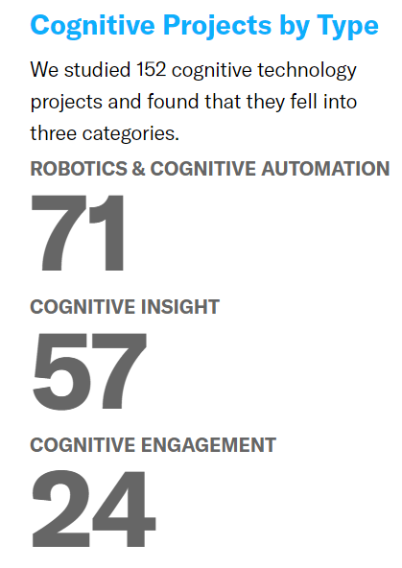
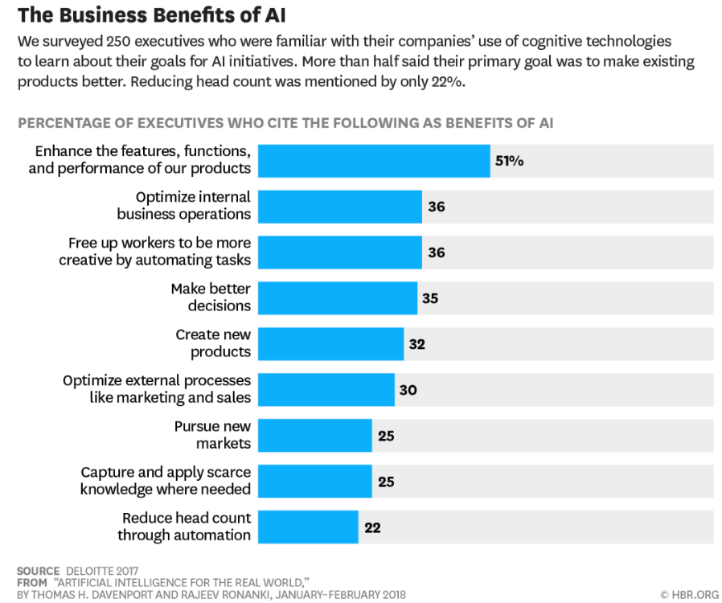
These applications of AI yields business benefits as surveyed by 250 executives on 152 technology projects.
Source: https://hbr.org/2018/01/artificial-intelligence-for-the-real-world

Slide 21
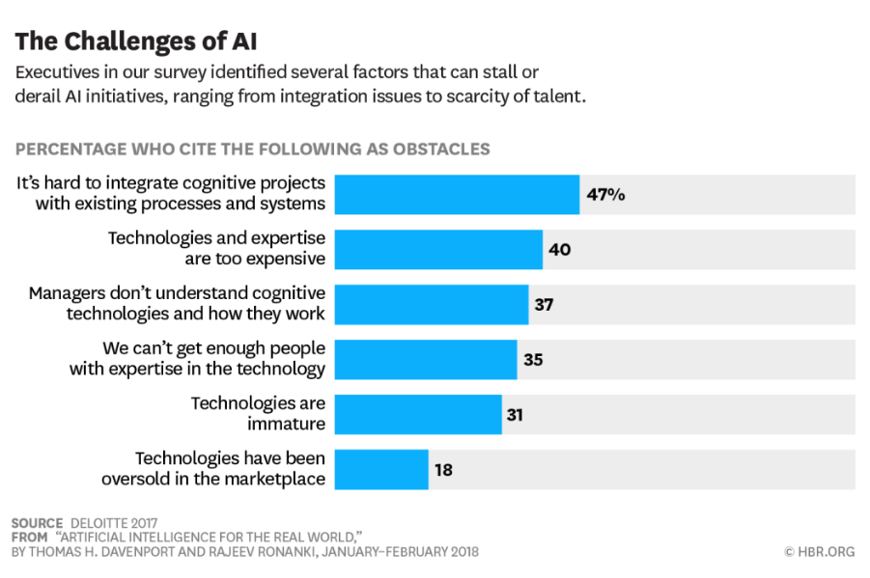
And these AI applications face some business challenges as surveyed by 250 executives on 152 technology projects.
Source: https://hbr.org/2018/01/artificial-intelligence-for-the-real-world
Notes:
Good news for the consultant in the audience you need consultant
Bad news, you need to grow your capabilities from the ground up

Slide 22
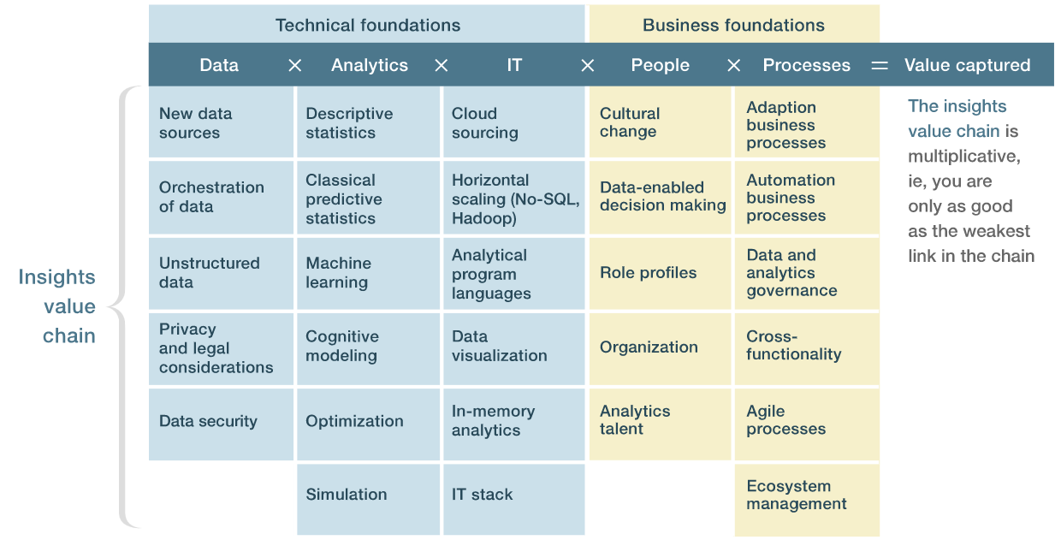
In order to face those challenges, organization that are capturing value from data are investing in all the component of the insights value chain.
Source: https://www.mckinsey.com/business-functions/mckinsey-analytics/our-insights/achieving-business-impact-with-data

Slide 23
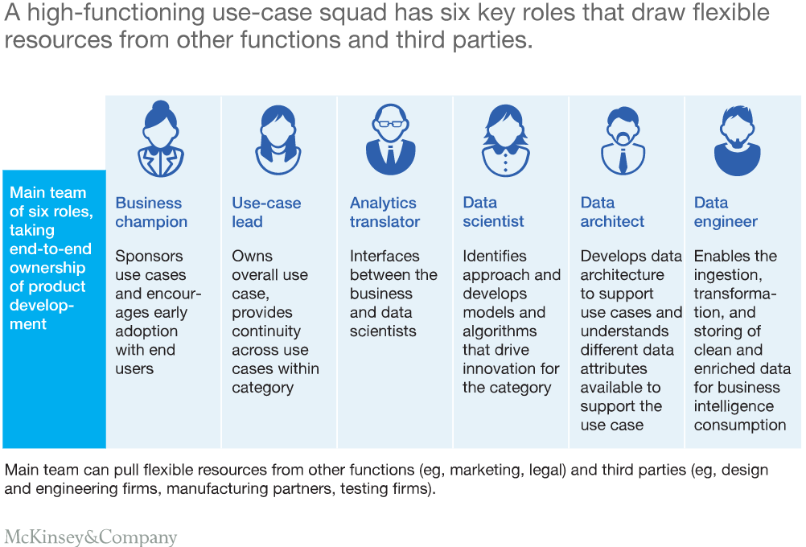
And when it comes to people, 6 different roles are to be played in organization to achieve success in integrating AI technologies.
Source: https://www.mckinsey.com/industries/retail/our-insights/geek-meets-chic-four-actions-to-jump-start-advanced-analytics-in-apparel

Slide 24
Summarizing my recommendations in a four-step framework for integrating AI technologies that can help your companies achieve its objectives
1. Understanding The Technologies
3. Launching Pilots
4. Scaling Up
2. Creating a Portfolio of Projects
Leverage capabilities of key employees
Build an ecosystem of external service providers
Establish a pool of resources
Identify opportunities
Pilot initiatives with high business value
Business process redesign with machines augmenting humans
Change management challenge
Detailed plan integrated with existing systems
Determine use cases
Select the technology
Source: https://hbr.org/2018/01/artificial-intelligence-for-the-real-world

Slide 25
Agenda
1
Intro to Beirut AI Business Workshop - Ali
2
Applied AI in Business - Ali
Intro AI
Applied AI World Case
Applied AI MENA Case
3
Introduction to Power BI – Elissar
Intro
Hands on
4
Marketing Business Case - Ali
Intro to the case
Solving Business Case – You
Presentation of solution – You
6
Conclusions – Ali
Summary
Vote on next Business AI workshop topics

Slide 26
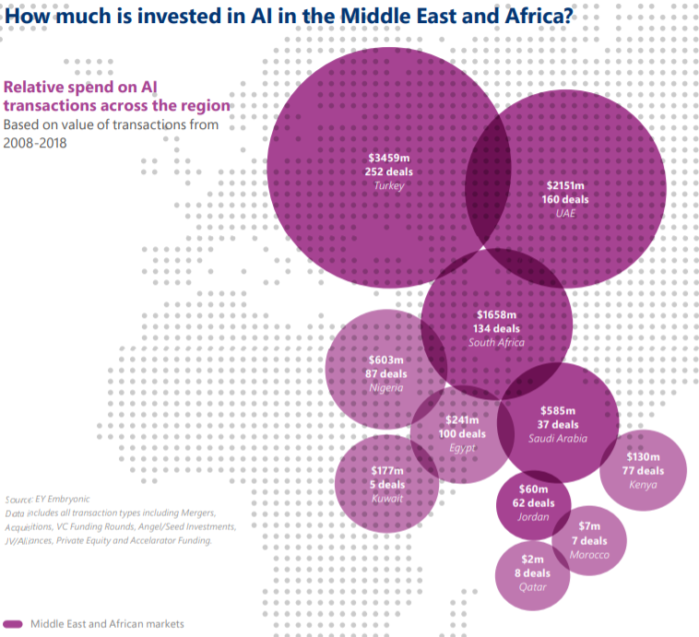
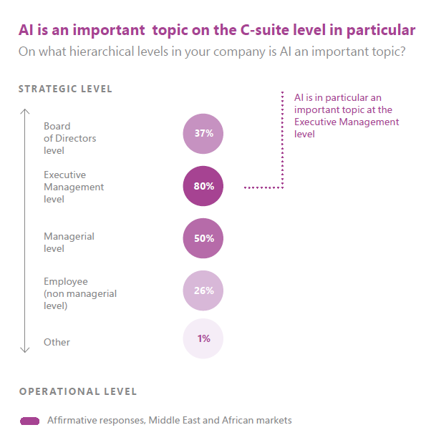
There is sizable investments in AI deals mainly in Turkey, UAE and Saudi Arabia and Executive are keeping an eye out on AI applications in their industry.
Source: https://info.microsoft.com/rs/157-GQE-382/images/report-SRGCM1065.pdf
Notes:
Mohammed in Zayed University of Artificial Intelligence
The UAE is on course to be the leading AI hub in the Middle East by 2030. A recent PwC report predicted that AI will be worth $320bn in the Middle East by 2030; in the UAE, AI is expected to make up 13.6 percent of GDP, followed by Saudi Arabia with 12.5 percent
Source: https://www.theparliamentmagazine.eu/articles/partner_article/why-middle-east-fast-becoming-hub-artificial-intelligence

Slide 27

What are business leaders saying about AI in the MENA region? [1/2]
Even during an economic downturn investing in data makes sense as AI can provide significant cost advantages and
efficiencies.
— Emaar
With AI, we understand our customer’s
behaviour, needs and preferences better and
offer customized marketing campaigns.
— Opet Petrolcülük A.Ş.
Solution offerings in the
market must be very mature
before companies invest in it,
there is a lot of Powerpoint
and not enough working
solutions with proven
examples.
— Arab Potash Company
AI isn’t only about new technology, it’s a new way of thinking.
— First Abu Dhabi Bank
Source: https://info.microsoft.com/rs/157-GQE-382/images/report-SRGCM1065.pdf

Slide 28
What are business leaders saying about AI in the MENA region? [2/2]
Within the new working
habits of the sector,
productivity and simplicity
strategies can be reached
via analyzing the data
with advanced analytics &
artificial intelligence.
— Allianz Turkey
We have been using AI mainly for automation to maximize
efficiency and increase accuracy, and currently are working
to use AI for predicting demand and consumers’ buying
behaviour.
― Nader Group
Quality data is essential to
unleash the real power of AI.
— Smart Dubai
The machine learning algorithms is often the
easy part - implementing it on live systems
with the required people, process and system
changes is the difficult one.
— Etihad
Our biggest challenge is the fear of negatively impacting
employment.
— Jordan Ministry of Labor
Source: https://info.microsoft.com/rs/157-GQE-382/images/report-SRGCM1065.pdf

Slide 29
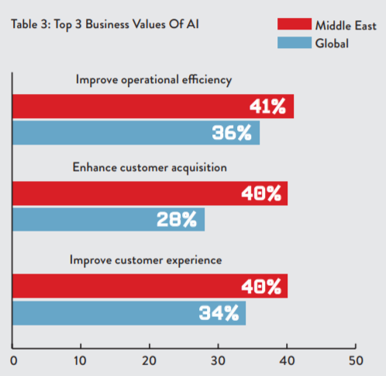
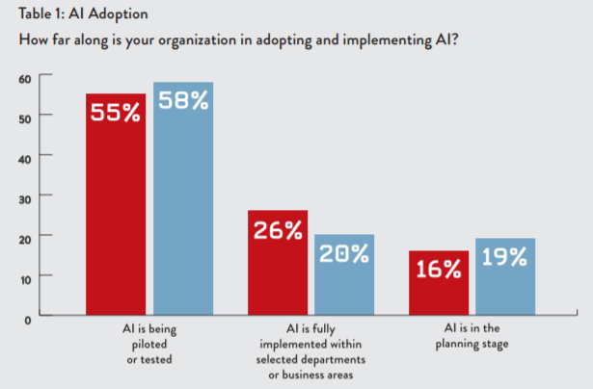
According to 100 C-suite executive in the MENA region the top business values of AI include operational improvements & customers experience while most report being in planning or implementation phase.
Source: https://ai-everything.com/wp-content/uploads/2019/04/State-of-AI-in-the-Middle-East-Forbes-Report.pdf
Notes:
Are we facing the same challenges in the MENA region?

Slide 30
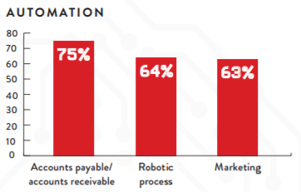
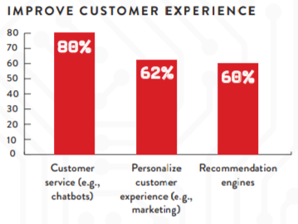
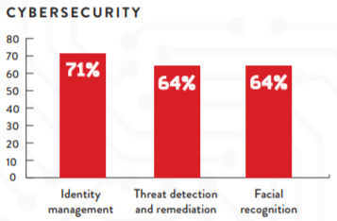
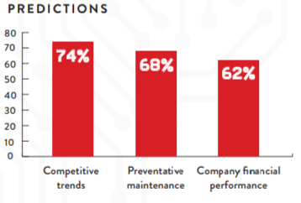
In the MENA region, Automation, Customer Experience, Cybersecurity and Predictions were cited as the major applications of AI technology.
Source: https://ai-everything.com/wp-content/uploads/2019/04/State-of-AI-in-the-Middle-East-Forbes-Report.pdf

Slide 31
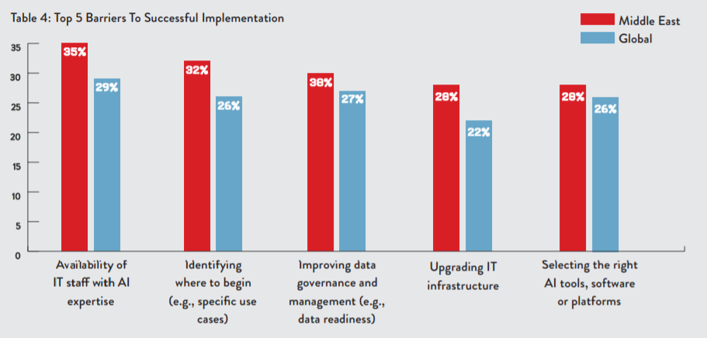
In the MENA region, the main barrier for AI adoption are finding staff with AI expertise, data governance and infrastructure.
Source: https://ai-everything.com/wp-content/uploads/2019/04/State-of-AI-in-the-Middle-East-Forbes-Report.pdf

Slide 32
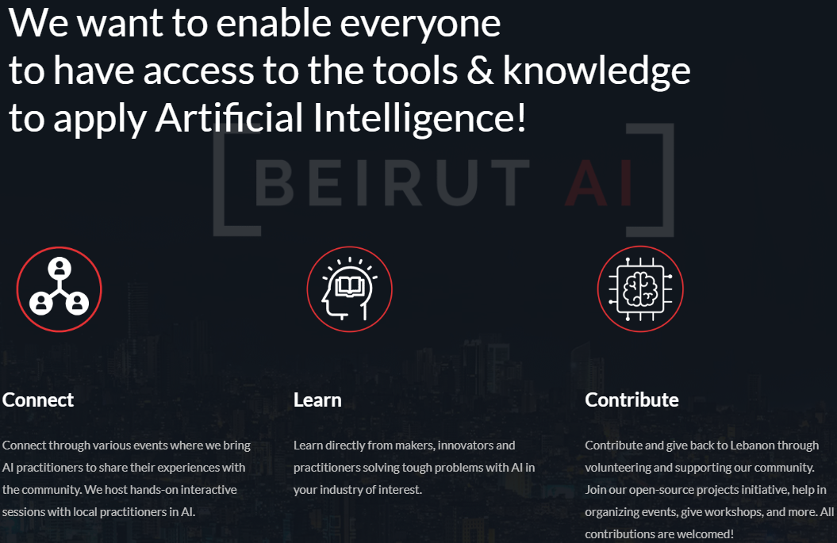
Which brings us back to our mission at Beirut AI…
Source: www.beirutai.org

Slide 33
Agenda
1
Intro to Beirut AI Business Workshop - Ali
2
Applied AI in Business - Ali
Intro AI
Applied AI World Case
Applied AI MENA Case
3
Introduction to Power BI – Elissar
Intro
Hands on
4
Marketing Business Case - Ali
Intro to the case
Solving Business Case – You
Presentation of solution – You
6
Conclusions – Ali
Summary
Vote on next Business AI workshop topics

Slide 34
Intro to Microsoft Power BI

Slide 35
What is Business Intelligence?
Business Intelligence (BI) refers to the technologies, application and practices for the collection, integration , analysis and presentation of business information
Purpose of BI: to support better decision making at the organization

Slide 36
The business intelligence process consists of 4 steps
Collect Data
Integrate Data
Analyze Data
Present Data

Slide 37
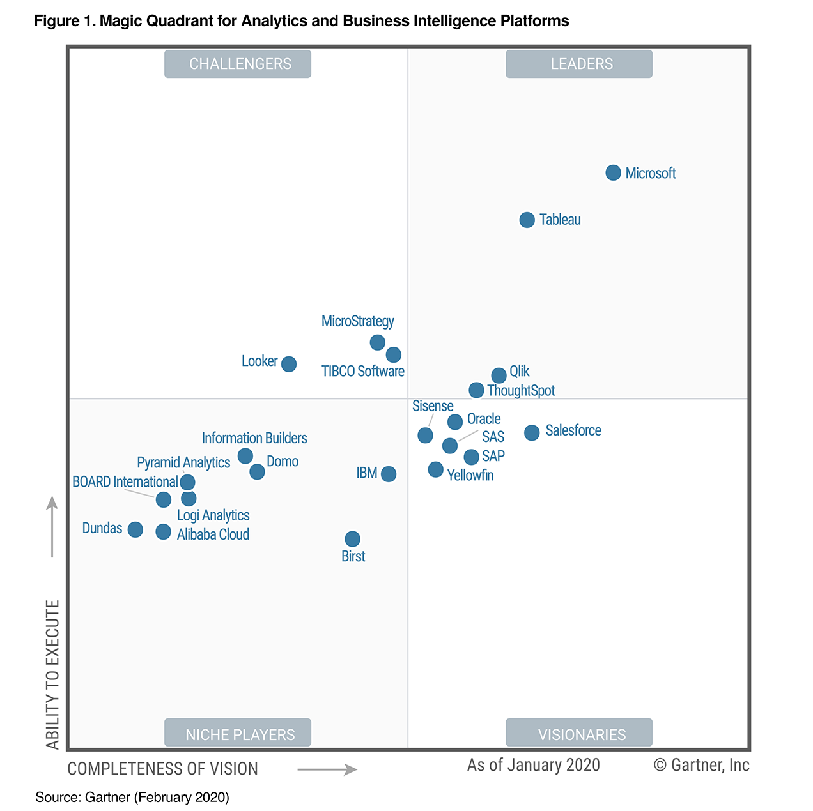






There are many tools available for business to implement Analytics and BI platforms
Selecting your Analytics & BI Platform
You can not go wrong with the selection of a platform. All platforms have good capabilities. However your organization need to make an assessment to the best adapted platforms for your case.
For this workshop, we selected PowerBI as an analytics tool.
Source: https://www.gartner.com/en/documents/3980852

Slide 38
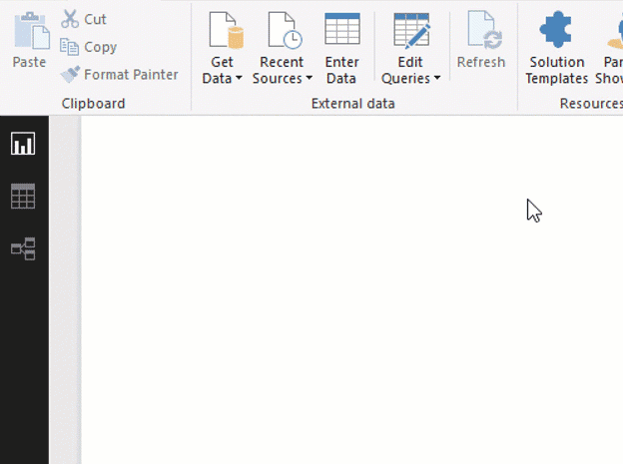
With Power BI you can work with a lot of different data types
Connect to your data, wherever it is
Access data from hundreds of supported on-premises and cloud-based sources, such as Dynamics 365, Salesforce, Azure SQL DB, Excel, and SharePoint. Ensure it’s always up to date with automated, incremental refreshes. Power BI Desktop enables you to develop deep, actionable insights for a broad range of scenarios.
Source: https://powerbi.microsoft.com/en-us/desktop/

Slide 39
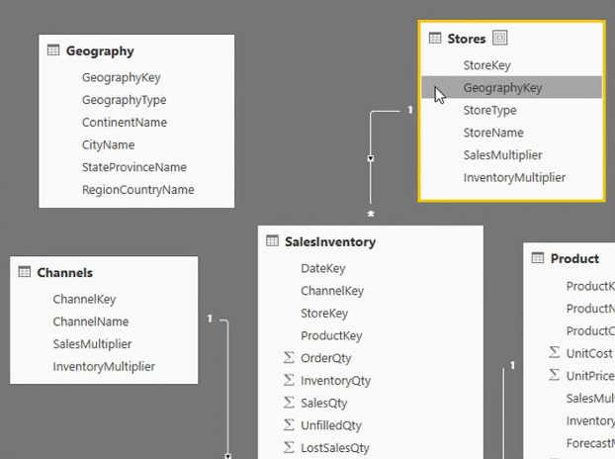
With Power BI you can prepare, clean and structure your data very easily
Prep and model your data with ease
Data prep can take most of your time, but it doesn’t have to with data modeling tools. Reclaim hours in your day using the self-service Power Query experience familiar to millions of Excel users. Ingest, transform, integrate and enrich data in Power BI.
Source: https://powerbi.microsoft.com/en-us/desktop/

Slide 40
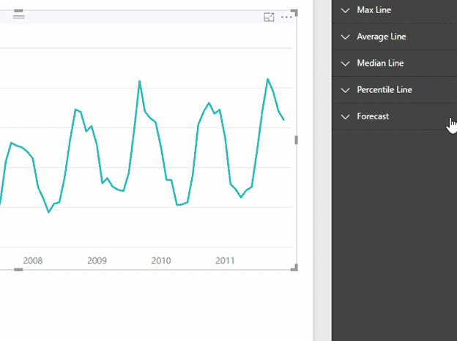
With Power BI you can do advanced analytics that are accessible to anyone
Provide advanced analytics with the familiarity of Excel
Dig deeper into data and find patterns you may have otherwise missed that lead to actionable insights. Use features like quick measures, grouping, forecasting, and clustering. Give advanced users full control over their model using powerful DAX formula language. If you’re familiar with Excel, you’ll feel at home in Power BI.
Source: https://powerbi.microsoft.com/en-us/desktop/

Slide 41
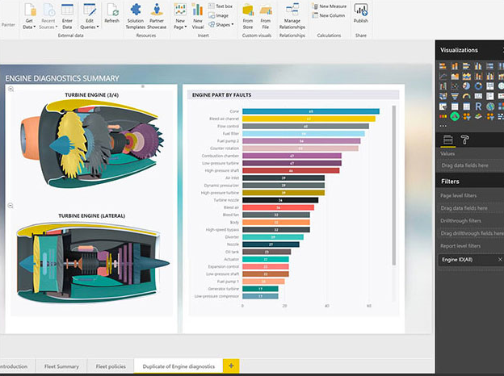
With Power BI you can create very easily customized reports for your business.
Create interactive reports customized for your business
Create stunning reports with interactive data visualizations. Tell your data story using a drag-and-drop canvas and hundreds of modern data visuals from Microsoft and partners—or create your own, using the Power BI open source custom visuals framework. Design your report with theming, formatting, and layout tools
Source: https://powerbi.microsoft.com/en-us/desktop/

Slide 42
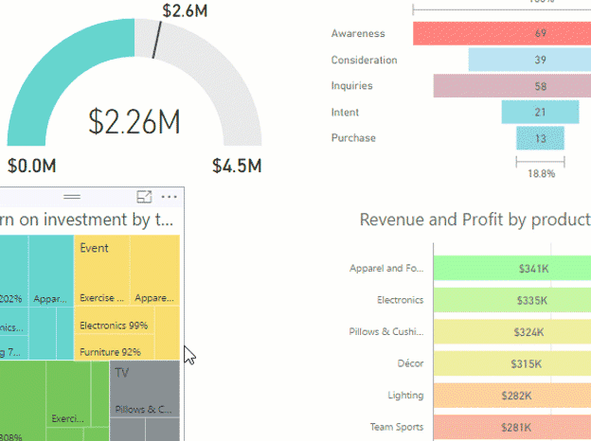
With Power BI you can share your reports with anyone on the web, on mobile, on desktop
Author for everyone, anywhere
Get visual analytics to the people who need it. Create mobile-optimized reports for viewers to consume on the go. Publish from Power BI Desktop to the cloud or on-premises. Embed reports created in Power BI Desktop into existing apps or websites.
Source: https://powerbi.microsoft.com/en-us/desktop/

Slide 43
Agenda
1
Intro to Beirut AI Business Workshop - Ali
2
Applied AI in Business - Ali
Intro AI
Applied AI World Case
Applied AI MENA Case
3
Introduction to Power BI – Elissar
Intro
Hands on
4
Marketing Business Case - Ali
Intro to the case
Solving Business Case – You
Presentation of solution – You
6
Conclusions – Ali
Summary
Vote on next Business AI workshop topics

Slide 44
Now is the time for a hands-on demonstration of Power BI Capabilities
Team formation:
Look to your left and right and form groups of 3 to 4 people
On this link, please add your name, and select a team name https://bit.ly/37uRi3D
Power BI demo:
If you have installed Power BI , please open the application
If you have not installed PowerBI please raise your hand, we will bring a USB flash drive for installation
Once you have Power BI running, please download the demo excel file from this link: https://bit.ly/2SN2y65

Slide 45
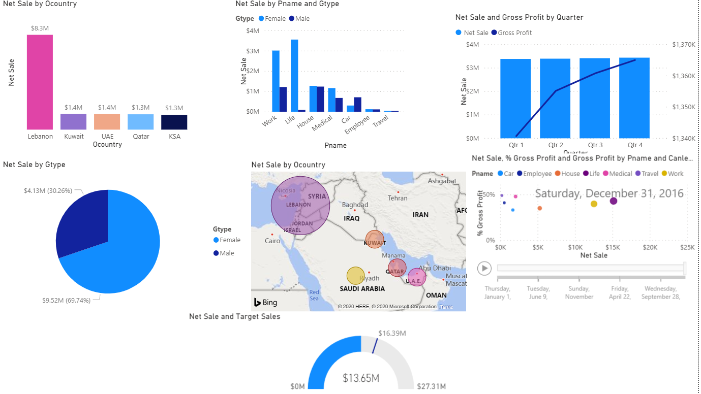
At the end of this demo, you will produce a dashboard that looks like this:

Slide 46
Agenda
1
Intro to Beirut AI Business Workshop - Ali
2
Applied AI in Business - Ali
Intro AI
Applied AI World Case
Applied AI MENA Case
3
Introduction to Power BI – Elissar
Intro
Hands on
4
Marketing Business Case - Ali
Intro to the case
Solving Business Case – You
Presentation of solution – You
6
Conclusions – Ali
Summary
Vote on next Business AI workshop topics

Slide 47
Marketing Analytics business case

Slide 48
Description of the business case
Challenge: Bank Marketing Campaigns
Due to recent financial crisis, a bank CEO wants to increase the amount of savings deposit of the existing bank customers base. He asked his Chief Marketing Officer (CMO) to increase the effectiveness of his marketing campaign to convince more customers to put money in a saving time deposited account.
The CMO typical marketing campaigns have been based on sending the same marketing message to all the customers in the bank database. The CMO team has 2 marketing resources, a graphic designer and a business analyst in addition to the bank customer support center. The marketing channels that the team used to reach their customers were a combination of phone calls, emails, sms and social media.
Recently the CMO has been hearing of advances in AI and data science. However since this is a new strange field to his team, he decided to bring you on board as a consulting team to design new processes that will increase the effectiveness of his marketing campaigns. Ultimately the CMO care about increasing customer life time value by increasing time saving deposits in this difficult period.
Data
As the team working for the CMO, you have access to data of the 2019 marketing campaigns. The first thing your consulting team does is collect and structure the data into one source of information in the form of one excel table. You set up the data as input fields and output fields. With input being all factors that might possibly affect your output which is “a customer subscribing to a long term deposit”. Assume that each new subscribed long term deposit account returns 200USD/year to the bank. Beside the usual inputs like customer demographics, different campaigns type, call information, you augment the data with socio economic indicators among other variables.
Outcome
In these tough economic times, you promise the bank CMO that your compensation is tied to a percentage increase in long term deposit plus a small retainer fee conditioned on the CMO implementing your recommendations.

Slide 49
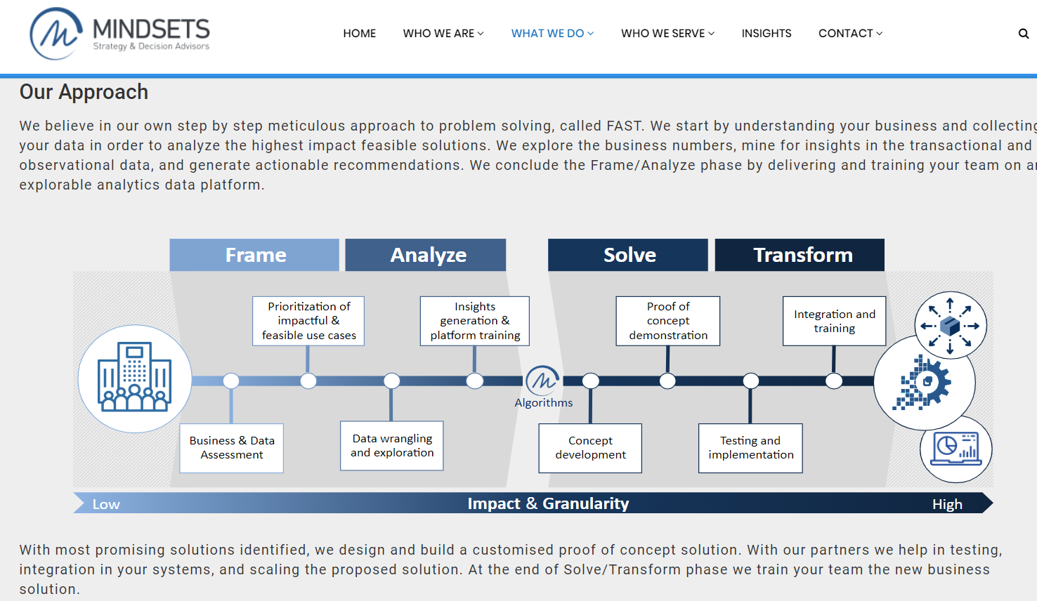

Slide 50
We will follow the Mindsets' FAST approach to solve the CMO marketing problem
Frame
Opportunity statement
Data Mapping
Analyze
Torture the data with questions
Create stories through an exploratory data analysis
Solve
Value Proposition
Develop AI model
Test & Evaluate
Map data to idea to process to value added
Transform
Deploy and scale solution
Integrate solution into existing business process
Train people on new solution
Generate alternatives for possible AI models
Suggest complementary solution (non AI)

Slide 51
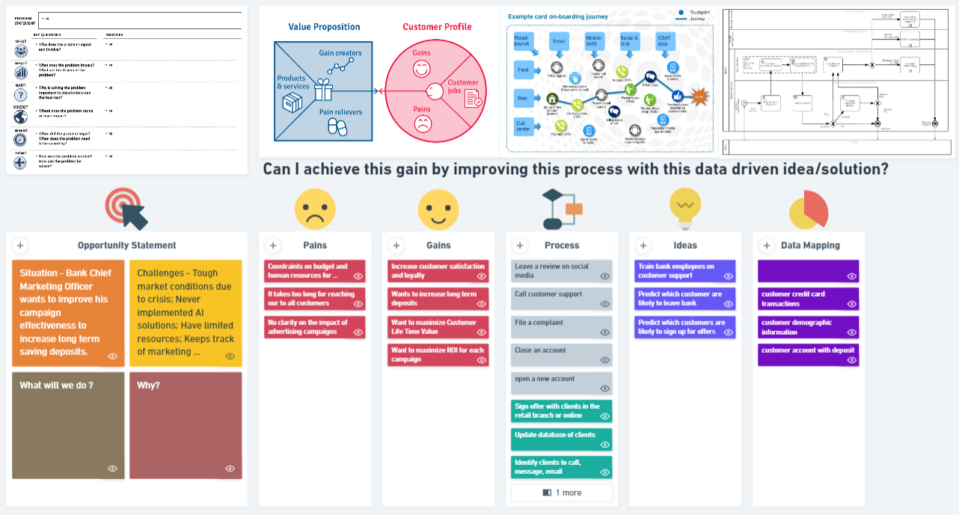
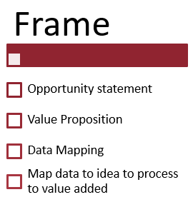
We will do the framing session together interactively while everyone can follow the live updates on the whimsical board below
Whimsical link to Framing exercise bit.ly/3bKvhkq

Slide 52
Agenda
1
Intro to Beirut AI Business Workshop - Ali
2
Applied AI in Business - Ali
Intro AI
Applied AI World Case
Applied AI MENA Case
3
Introduction to Power BI – Elissar
Intro
Hands on
4
Marketing Business Case - Ali
Intro to the case
Solving Business Case – You
Presentation of solution – You
6
Conclusions – Ali
Summary
Vote on next Business AI workshop topics

Slide 53
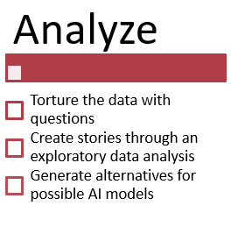
Now that we are in alignment on what problem we are solving and what potential solutions might be offered, each team will start the Analyze phase by looking at the existing marketing campaign data.
Variable | Description
age | Numeric
job | type of job (categorical 'admin.','blue-collar', 'entrepreneur', 'housemaid', 'management', 'retired' ,'self-employed', 'services', 'student', 'technician', 'unemployed', 'unknown')
marital | marital status (categorical 'divorced', 'married', 'single', 'unknown'; note 'divorced' means divorced or widowed)
education | (categorical 'basic.4y', 'basic.6y','basic.9y', 'high.school', 'illiterate', 'professional.course', 'university.degree', 'unknown')
default | has credit in default? (categorical 'no', 'yes', 'unknown')
housing | has housing loan? (categorical 'no', 'yes', 'unknown')
loan | has personal loan? (categorical 'no', 'yes', 'unknown')
month | last contact month of year (categorical 'jan', 'feb', 'mar', ..., 'nov', 'dec')
day_of_week | last contact day of the week (categorical 'mon','tue','wed','thu','fri')
duration | last contact duration, in seconds (numeric
interaction | number of contacts performed during this campaign and for this client (numeric, includes last contact)
call.direction | Call direction wether from customer inbound, or from agent outbound - categorical ('inbound', 'outbound')
Cid | Campaign Id that led to the call corresponding to categorical ('Facebook','Instagram','LinkedIn','Email','Call','SMS')
pdays | number of days that passed by after the client was last contacted from a previous campaign (numeric; 999 means client was not previously contacted)
previous | number of contacts performed before this campaign and for this client (numeric)
poutcome | outcome of the previous marketing campaign (categorical 'failure','nonexistent','success')
emp.var.rate | employment variation rate - quarterly indicator (numeric)
cons.price.idx | consumer price index - monthly indicator (numeric)
cons.conf.idx | consumer confidence index - monthly indicator (numeric)
euribor3m | euribor 3 month interest rate - daily indicator (numeric)
nr.employed | number of employees - quarterly indicator (numeric)
y | has the client subscribed a term deposit? (binary: 'yes', 'no')
Link to datafile to download bit.ly/2Hv0uKB

Slide 54
Sample questions to help you extract insights from the data. Choose a combination of these questions to create your data stories on a Power BI Dashboard.
Does the customer education affect long term deposit subscriptions?
Are customers with better job profiles more likely to subscribe to long term deposits?
Is a customer with a history of loan defaults less likely to subscribe to a long term deposit?
Are customer with house loans more likely to subscribe to long term deposits?
Does the call duration affect long term deposit?
Is the customer more likely to subscribe to a long term deposit if he called (inbound) or was called (outbound)?
Is the customer more likely to subscribe if the agent gives him a differential interest rate advantage?
Does the agent experience affect long term deposit? Does the agent gender affect long term deposit?
Does the customer bank loans affect long term deposit?
Is the customer more likely to subscribe to a long term deposit if he called or got called?
Which campaign type has the best benefit cost ratio?
How would you recommend the Marketing Manager to invest in future campaigns?
What is the average customer acquisition cost in general, and per campaign for long term deposits?
Does the national interest rate affect long term deposit?
Are customers long term deposit decisions affected by economic indicators?
Does the day of the call affect long term deposit?
How many new long term deposit resulted from the marketing campaigns?
Do you recommend creating multiple marketing campaigns to each customer profile? Justify your answer.
Whimsical link with mind map supplementary questions bit.ly/37vFVID

Slide 55
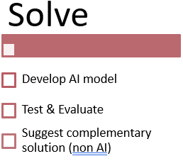

It is out of the scope of this workshop to create an AI model to predict if the client will subscribe or not to a long term deposit. You can learn how to create AI models in Beirut AI Technical workshops.
Assume you have a working AI model to be deployed and scaled at the customer premises
Feel free to suggest parallel solutions not AI related that will help achieve the CMO goal

Slide 56
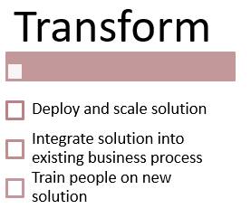
As part of your contract, you are required to deliver your solution by presenting to the board of directors of the Bank before getting approval for deployment.
Prepare a couple of slides outlining your
Understanding of the business opportunity
Your framing of the potential solutions areas
Your insights extracted from the data in PowerBI
Your recommended solutions with an estimated Return On Investment (feel free to make necessary assumption or ask facilitators) if implemented
Present to your colleagues your solution (3 min)
Use template slides provided to structure your work
Link to template slides bit.ly/2HFlsXz

Slide 57
We are here to help any questions you might have while you work through the business case understanding, torture the data, generate insight, and package your solution for a presentation.
Any Questions?
Useful Links
Whimsical link to Framing exercise bit.ly/3bKvhkq
Link to datafile to download bit.ly/2Hv0uKB
Whimsical link with mind map supplementary questions bit.ly/37vFVID
Link to template slides https://bit.ly/2HFlsXz
Link Team members and name https://bit.ly/37uRi3D

Slide 58
Agenda
1
Intro to Beirut AI Business Workshop - Ali
2
Applied AI in Business - Ali
Intro AI
Applied AI World Case
Applied AI MENA Case
3
Introduction to Power BI – Elissar
Intro
Hands on
4
Marketing Business Case - Ali
Intro to the case
Solving Business Case – You
Presentation of solution – You
6
Conclusions – Ali
Summary
Vote on next Business AI workshop topics

Slide 59
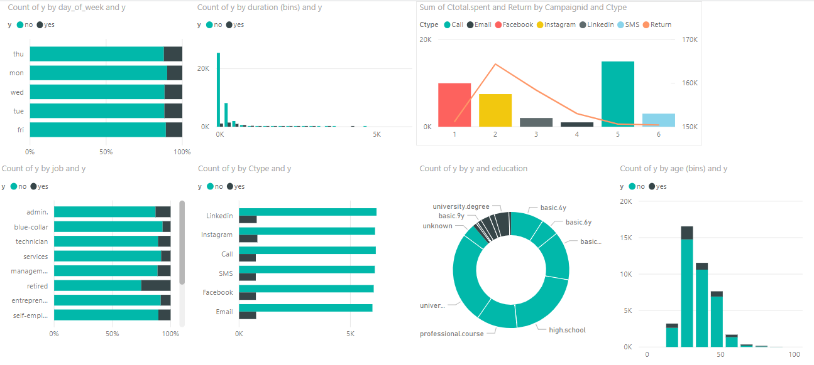
Example of some of the questions answered through a Power BI dashboard [1/2]

Slide 60
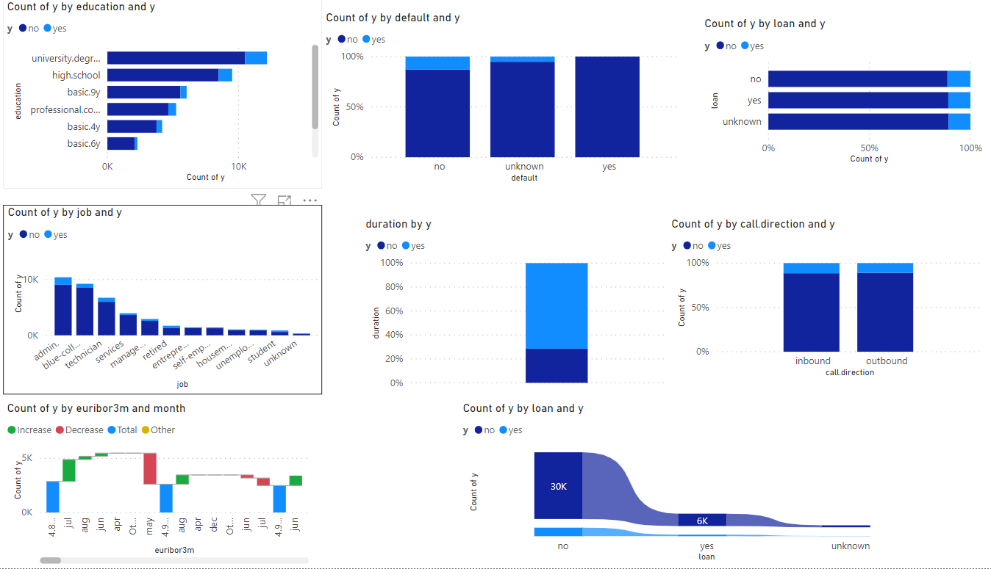
Example of some of the questions answered through a Power BI dashboard [2/3]

Slide 61
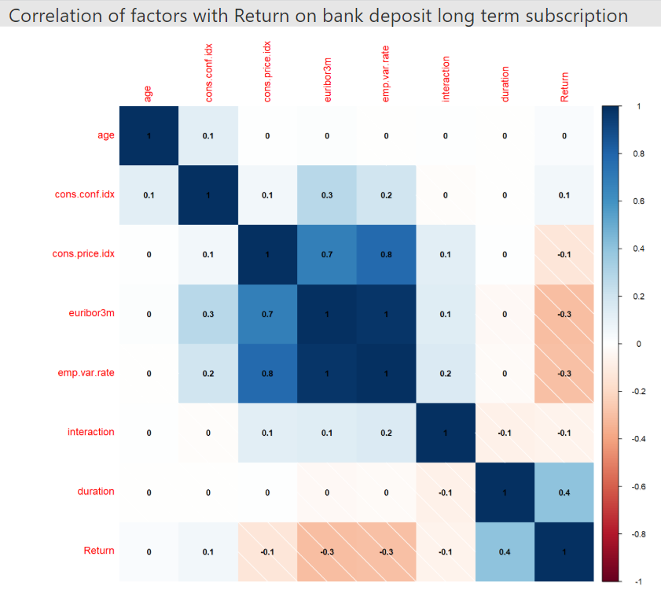
Example of some of the questions answered through a Power BI dashboard [3/3]

Slide 62
This business case was inspired from a real world scenario with a bank in Portugal. For more information about his case read the paper cited below.
Academic Paper
Moro, Sérgio, Paulo Cortez, and Paulo Rita. "A data-driven approach to predict the success of bank telemarketing." Decision Support Systems 62 (2014): 22-31.
Link to the paper
http://media.salford-systems.com/video/tutorial/2015/targeted_marketing.pdf
Data Source
https://archive.ics.uci.edu/ml/datasets/Bank+Marketing?package=regsel&version=0.2

Slide 63
Agenda
1
Intro to Beirut AI Business Workshop - Ali
2
Applied AI in Business - Ali
Intro AI
Applied AI World Case
Applied AI MENA Case
3
Introduction to Power BI – Elissar
Intro
Hands on
4
Marketing Business Case - Ali
Intro to the case
Solving Business Case – You
Presentation of solution – You
6
Conclusions – Ali
Summary
Vote on next Business AI workshop topics

Slide 64
Conclusions

Slide 65





In this Marketing Analytics Business AI Workshop you were able to experience the following:
Learn about AI from the business perspective
Learn about Power BI as an analytics tool
Gain insights about analyzing business problems
Connect with fellow Business AI minds
Practice presenting your ideas clearly with business impact in mind

Slide 66
Agenda
1
Intro to Beirut AI Business Workshop - Ali
2
Applied AI in Business - Ali
Intro AI
Applied AI World Case
Applied AI MENA Case
3
Introduction to Power BI – Elissar
Intro
Hands on
4
Marketing Business Case - Ali
Intro to the case
Solving Business Case – You
Presentation of solution – You
6
Conclusions – Ali
Summary
Vote on next Business AI workshop topics

Slide 67
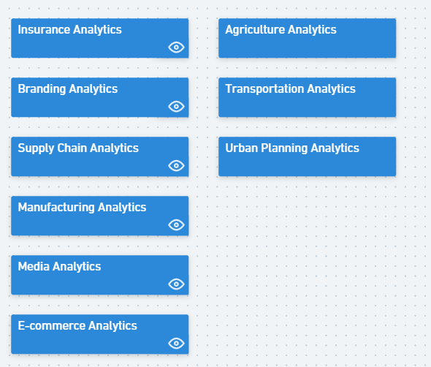
Vote on topic for next Business AI Workshop or suggest new topics not included in the list
Whimsical link to vote towards next workshop topic https://bit.ly/321iHJ7

Slide 68
Appendix

Slide 69
Some common uses of AI in banking
ATMs: Image/face recognition using real-time camera images and advanced AI techniques such as deep learning can be used at ATMs to detect and prevent frauds/crimes.
Fraud Detection: Anomaly detection can be used to increase the accuracy of credit card fraud detection and anti-money laundering.
Customer Support and Helpdesk: Humanoid Chatbot interfaces can be used to increase efficiency and reduce the cost for customer interactions.
Risk Management: Tailored products can be offered to clients by looking at historical data, doing risk analysis, and eliminating human errors from hand-crafted models.
Security: Suspicious behaviour, logs analysis, and spurious emails can be tracked down to prevent and possibly predict security breaches.
Digitization and automation in back-office processing: Capturing documents data using OCR and then using machine learning/AI to generate insights from the text data can greatly cut down back-office processing times.
Wealth management for masses: Personalized portfolios can be managed by Bot Advisors for clients by taking into account lifestyle, risks, expected returns on investment, etc.
Source: https://towardsdatascience.com/role-of-ai-in-developing-countries-banking-sector-54a5e99d4bf

Slide 70
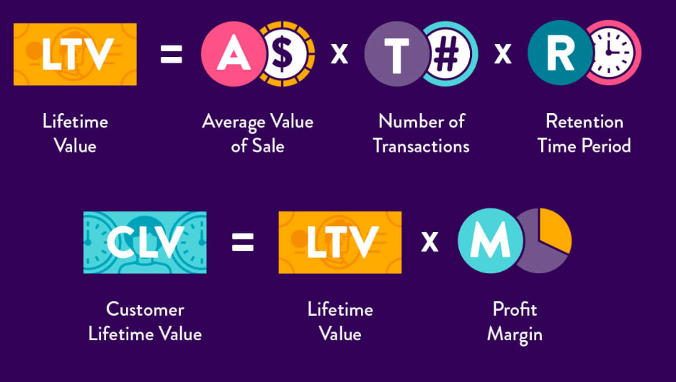
Customer life time value calculations
Source: https://clevertap.com/blog/customer-lifetime-value/

